Slide 1
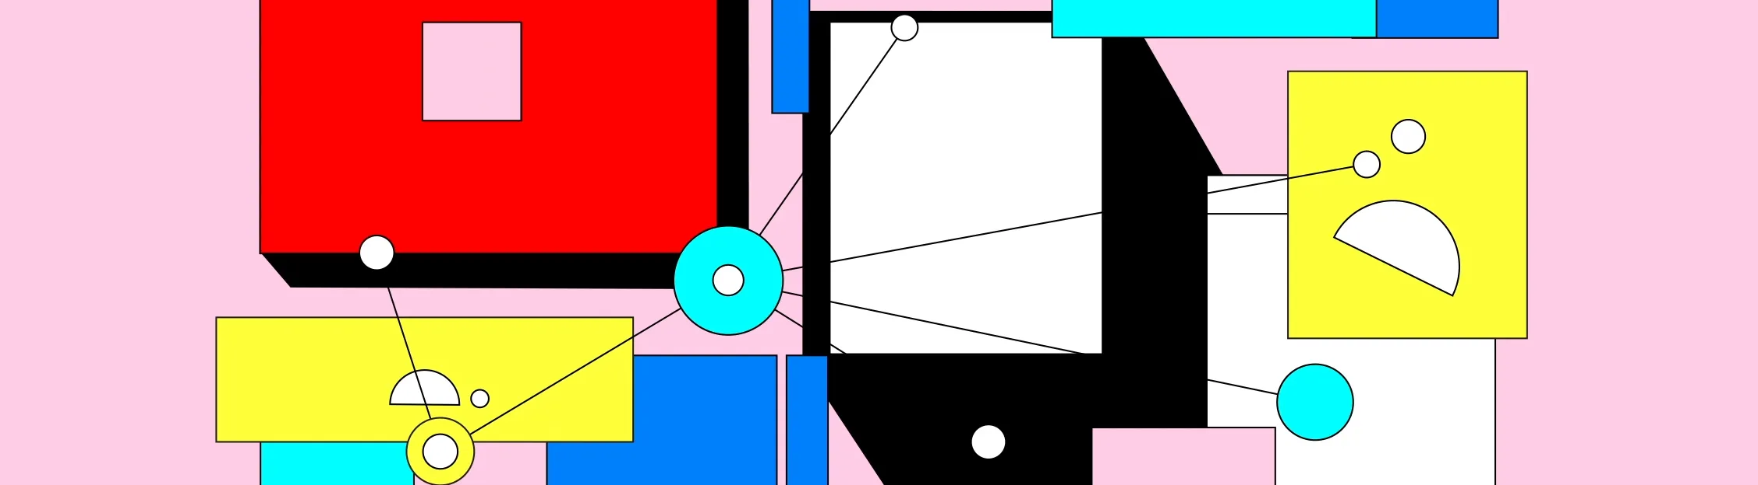
Open-Source Software
BSides Colorado Springs September 14, 2024
Not as Simple as you may Think
Jacob Latonis

Slide 2

whoami
Name: Jacob Latonis
What I do: Staff Software Engineer, Threat Research @ Proofpoint
Residing in: Boulder, CO
What I do for fun: cycling, running, reading, hiking, open source development
@jacoblatonis

Slide 3

Contents
If it’s online and available, it’s free to use and modify, right?
01 - The origins of open-source
02 - Open-source communities
03 - Complexity in the community
04 - Leveraging open-source
05 - Contributing to open-source
06 - Modern open-source projects

Slide 4
before we dive in
who in the room has used open source software?

Slide 5
Literally all of you

Slide 6
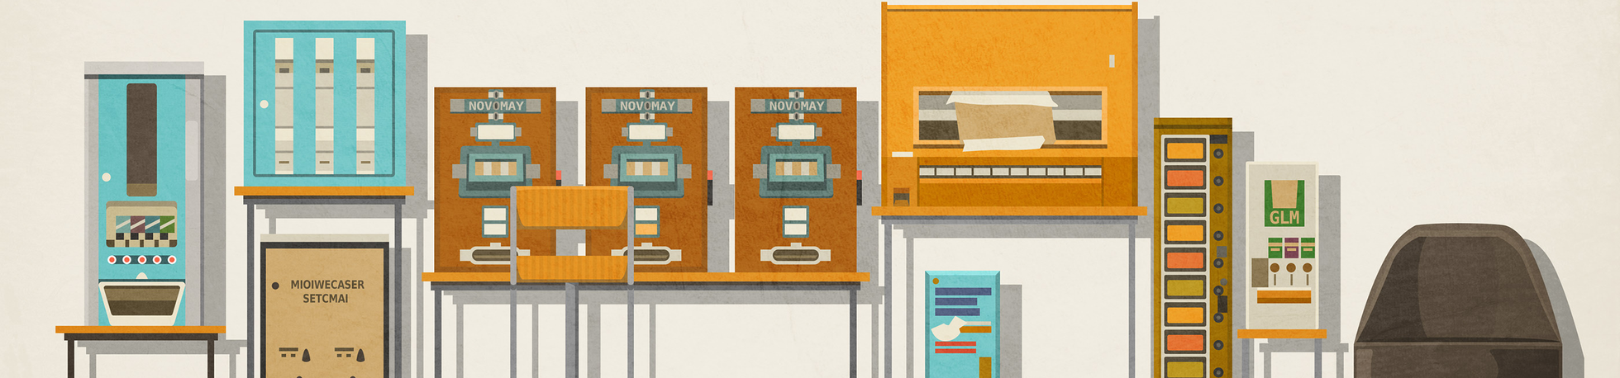
01 - The origins of open-source technology
why work out in the open?
what’re the benefits?
drawbacks?
the origins can be a bit murky as to the EXACT start, but there are some prominent characters and projects along the way

Slide 7
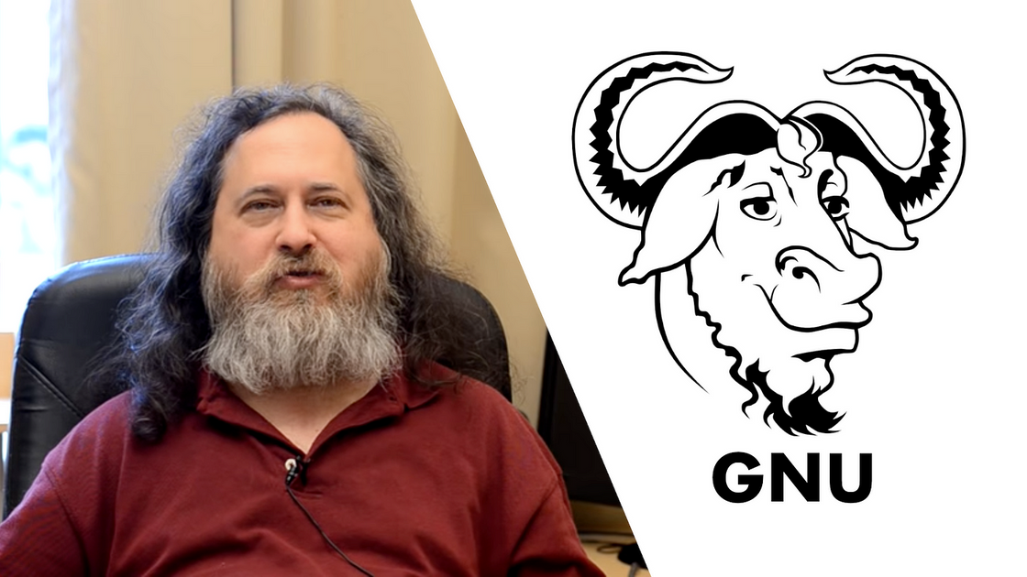
How did it start?
Richard Stallman
released GNU on September 27, 1983
GNU
GNU Public License
Notes:
free as in free speech, not free as in free beer

Slide 8
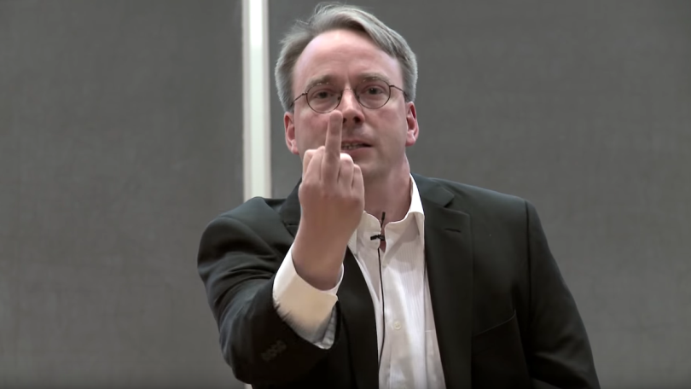
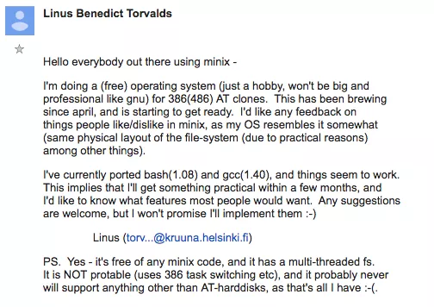
How did it start?
Linus Torvalds
released linux (sort-of) on August 25, 1991
Notes:
bazaar

Slide 9
Two main modes of operation
Cathedral
Bazaar
Deeper level of knowledge needed
Planning
Reasoning
Mostly the same ideals and techniques
Planning but not rigid
Different folks, different strokes
fast moving, many parts
could be considered a bit messy

Slide 10

02 - Open-source communities
The word “community” in open source can mean a lot.
user bases
developers
foundations
the list goes on

Slide 11

Federations
Federations can be defined as groups/projects with high contributor growth and high user growth. The number of users for the project is growing at a steady rate, and so is the number of contributions.

Slide 12
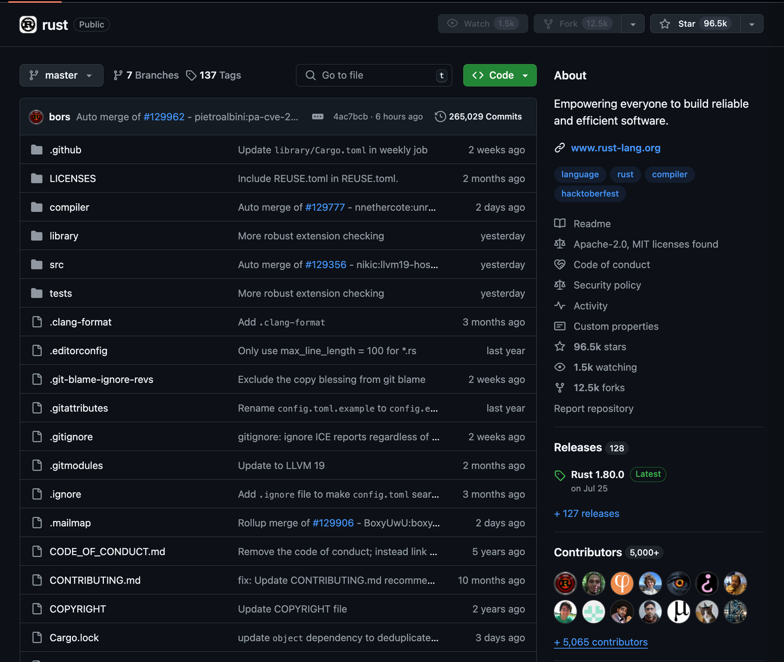
Examples of Federations
The most recent prominent example is probably the Rust foundation

Slide 13
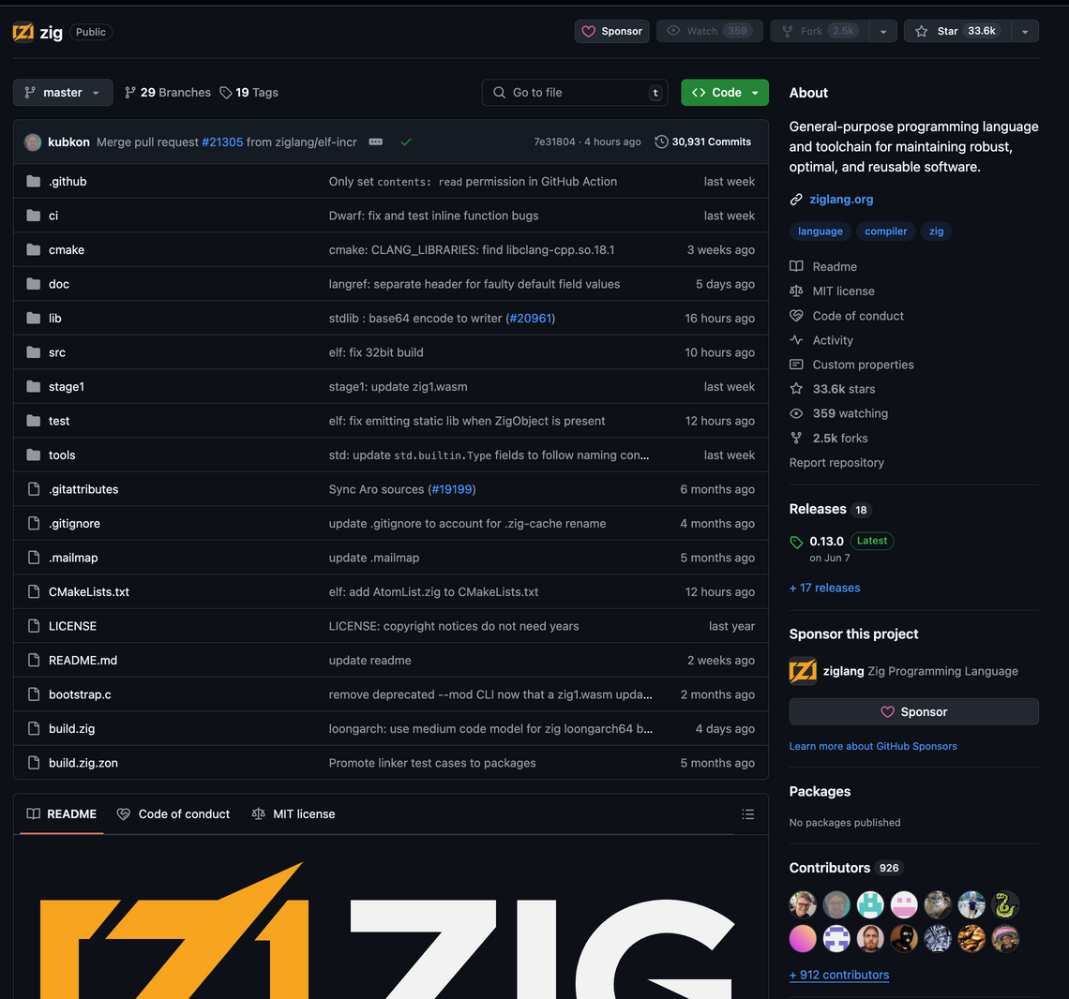
Examples of Federations (cont’d)
I also included Zig so I am not bullied after this talk by the 3 people in the room that like Zig

Slide 14

Clubs
Clubs are usually niche communities in the open-source community where the user base doesn’t quite grow at a steady rate, but many of the users present in the community are also contributors. This allows for a community that could be evenly numbered in contributor and user counts.

Slide 15
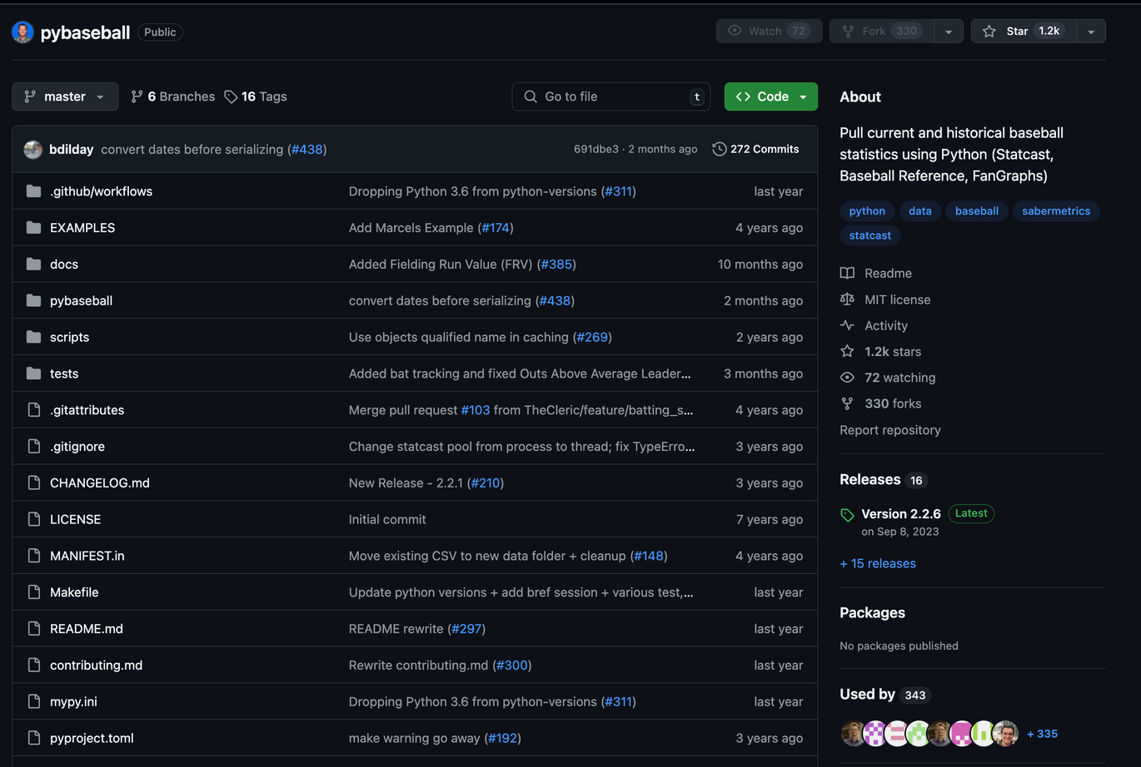
Examples of Clubs
clubs usually revolve around niche interests where the projects arose for very specific use-cases or needs.

Slide 16
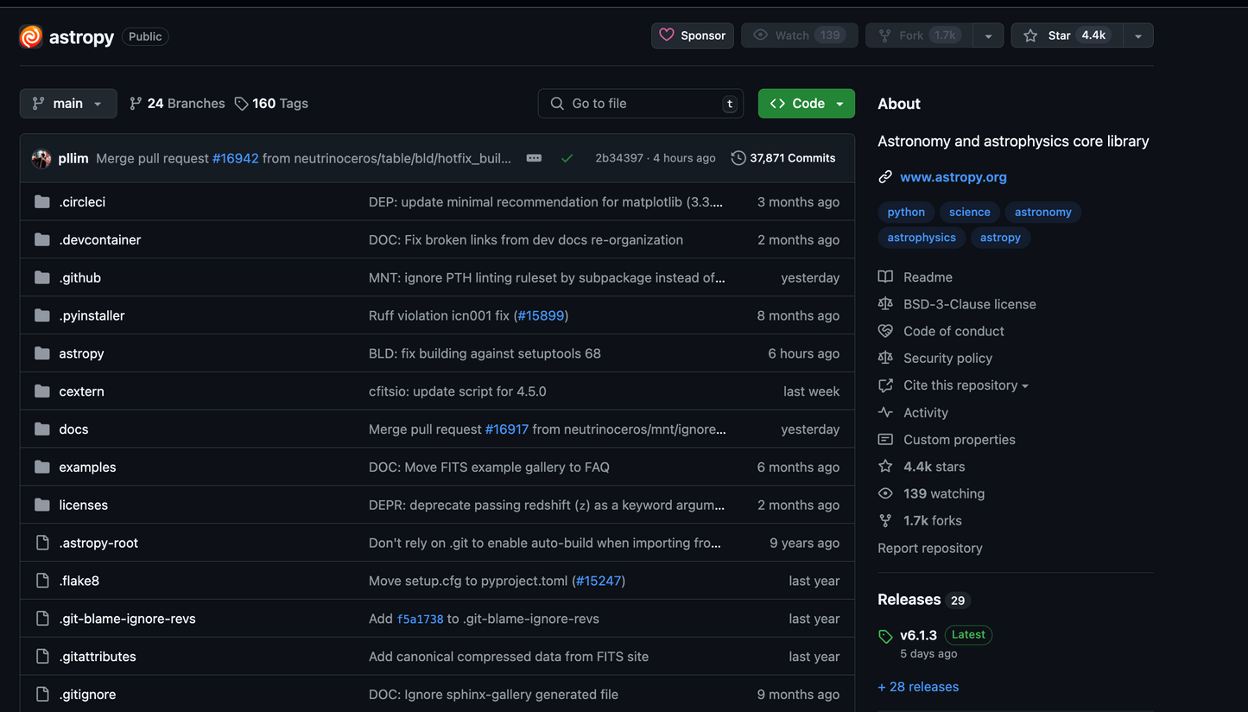
Examples of Clubs (cont’d)
clubs usually revolve around niche interests where the projects arose for very specific use-cases or needs.

Slide 17

Stadiums
Stadiums are communities that watch/rely on a very small subset of contributors to a project to keep it running, this can be due to a specialization of knowledge or due to the core maintainer working alone on purpose

Slide 18
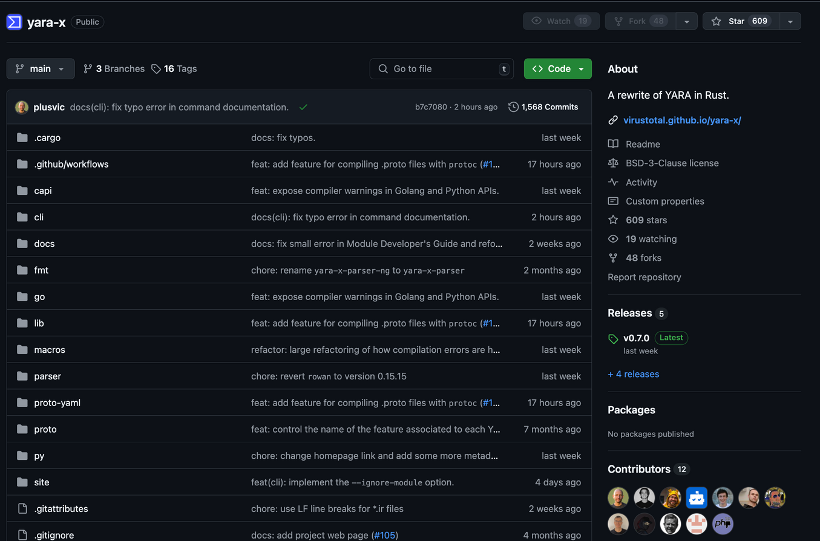
Examples of Stadiums
Stadiums are generally widely-used projects that have a small, core subset of contributors over time.
The user-base generally grows much, much faster.

Slide 19

03 - Complexity in the community
communities grow over time, and it almost always introduces complexity along the way.
technically complex
bureaucratically complex
just complex

Slide 20





Communicating in the community
Communicating and reporting issues, bugs, findings, use-cases, etc. is usually where the community first starts to find some complexity

Slide 21
Communicating in the community (cont’d)
where do i report this bug?
github
how do i ask questions?
discord
stackoverflow
is this expected behavior?
post in every channel that exists
yes, including that mailing list

Slide 22
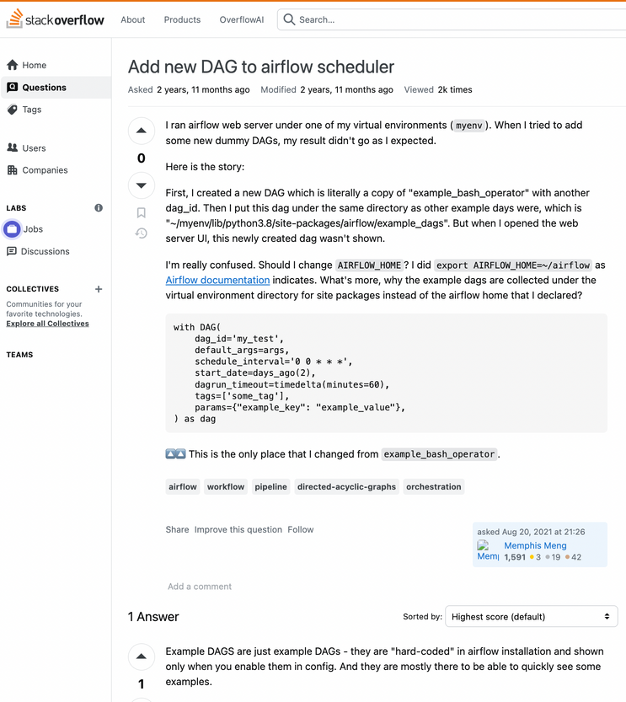
Documentation for the community
Where documentation lies can play a huge role in adoption and use
do users need to navigate away from the website or repo?
do users struggle with getting started with the project?

Slide 23
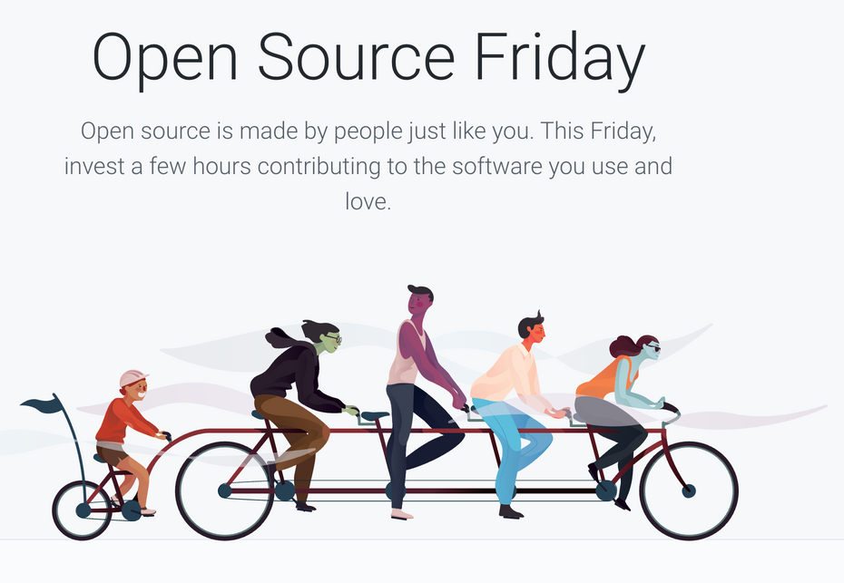
Contributing to the community
Contributing can get messy at times
resources exist to learn how to contribute, where to contribute, why to contribute, etc.
It can be intimidating but it is not impossible

Slide 24
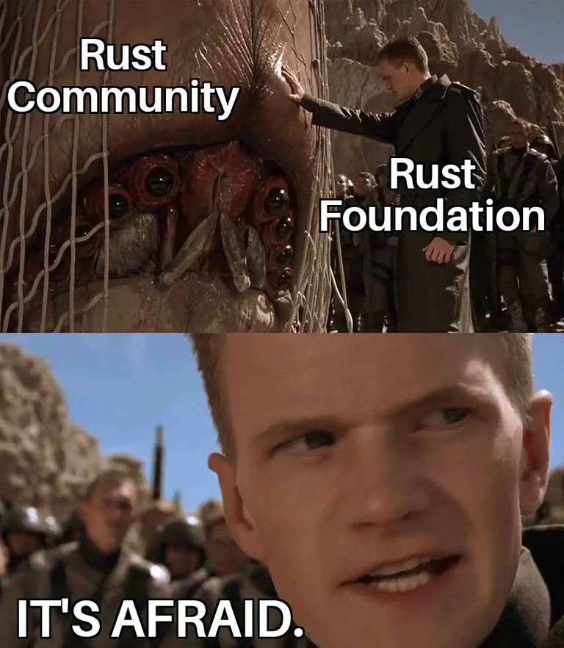
Does the community actually have a say?
The community doesn’t always know what’s best, or does it?

Slide 25
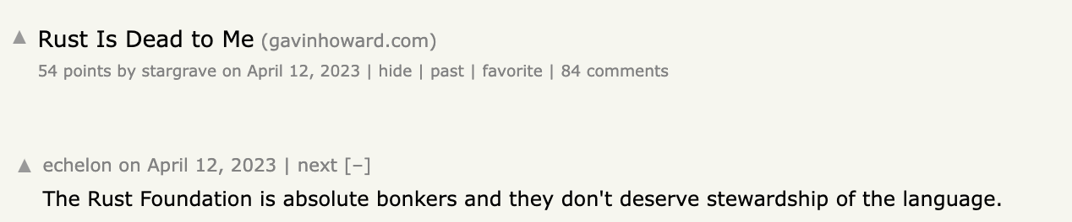
Does the community actually have a say?
examples of this:
license changes by the supporting org
legal changes
features/priorities against the status quo

Slide 26
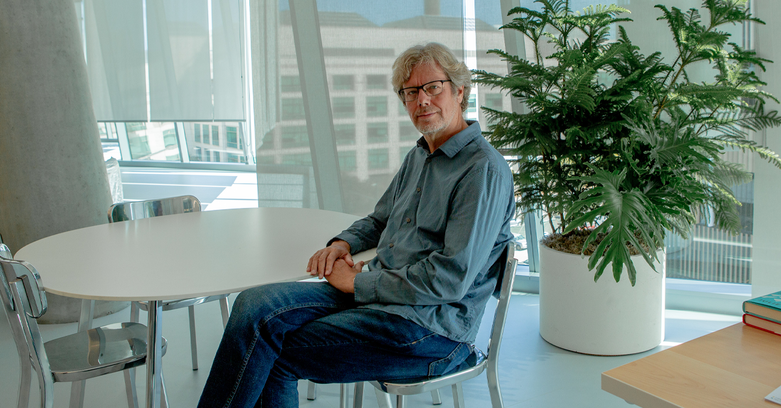
Who is this?
Notes:
Guido van Rossum for BDFL of Python

Slide 27
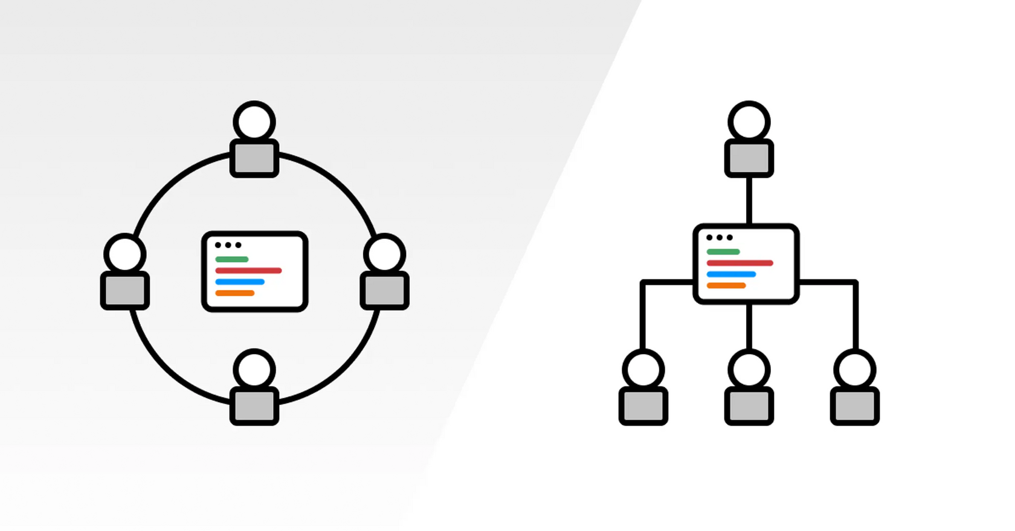
Benevolent Dictator for Life (BDFL) Model

Slide 28
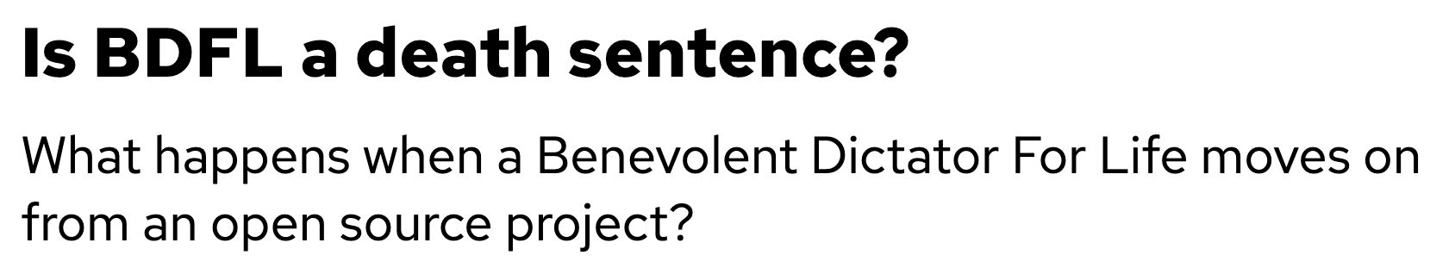
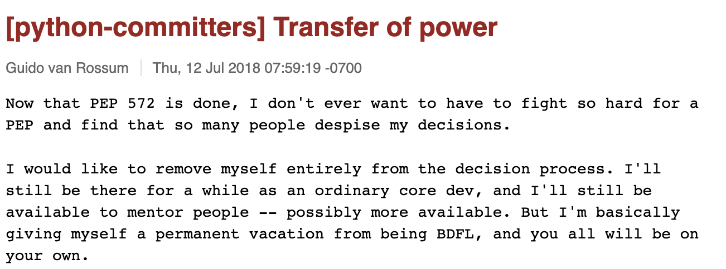
Benevolent Dictator for Life Model
maybe
no
yes

Slide 29
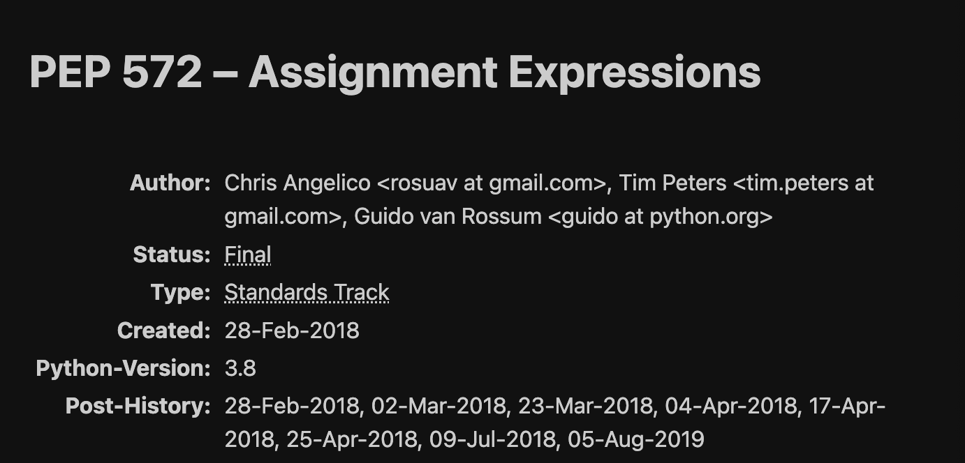
PEP 572
maybe
no
yes
Notes:
The drama was about a new expression being added to Python :=. What this does is it allows you to assign a value to a variable and return a boolean (True/False) value. This helps code with being able to use less lines to do the same thing. Consider the following code: https://pastebin.com/gasUuthM
Guido has been the Benevolent Dictator for Python for quite a while. He would determine what does and does not make it into the official releases of Python.
He took a lot of time to consult various groups and listened to many people. A large portion of the community was against this change, however Guido saw the value that adding that expression could add. So he approved it for the next release of Python (3.8).
Keep in mind that for a while Guido has fought with the community on several occasions. This was just the straw that broke the camel's back.
The problem that this change brings, is that it sacrifices code readability. In the example I linked, the first block is readable to new and veteran devs. It's easy to see and step through each line. On the second block though, having that shortcut does obfuscate the code quite a bit basically adding more "magic" to the code even if it's easy to explain.

Slide 30
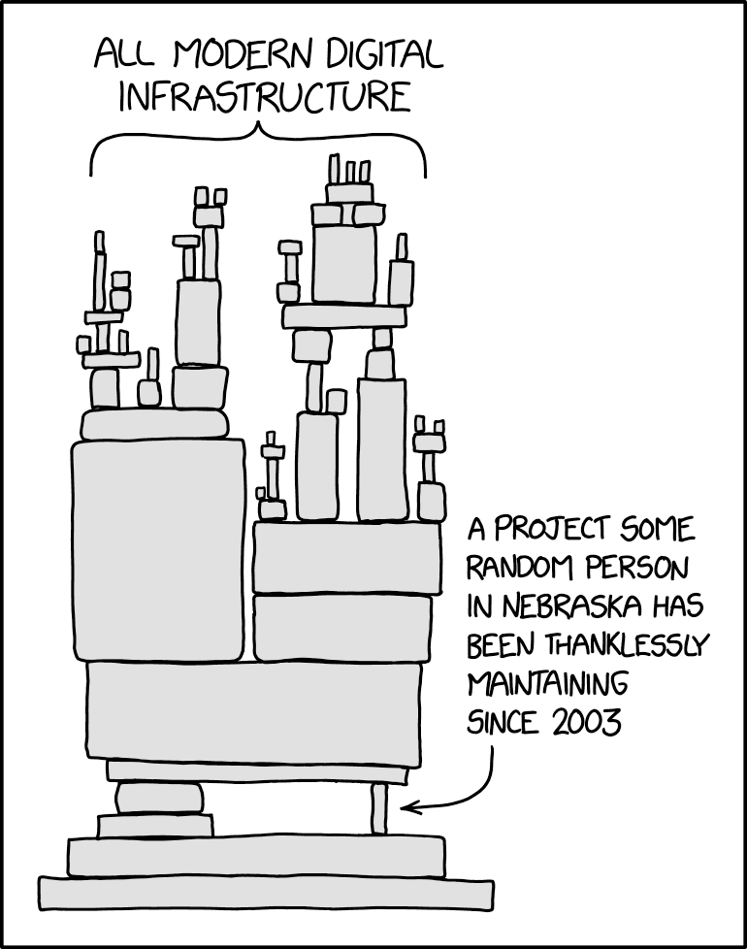
04 - Leveraging open-source
You plan to leverage some open-source technology? Do you know what you could possibly encounter?

Slide 31

The security aspect
There’s quite a few security aspects you need to consider with open-source. Open-source may have more eyes on the code base, but it doesn’t mean it’s inherently more secure.
vulnerabilities and mistakes happen in all software

Slide 32
The security aspect
When you pull in an open-source library for your next project, are you really gonna read every single line of source code? any of it?

Slide 33
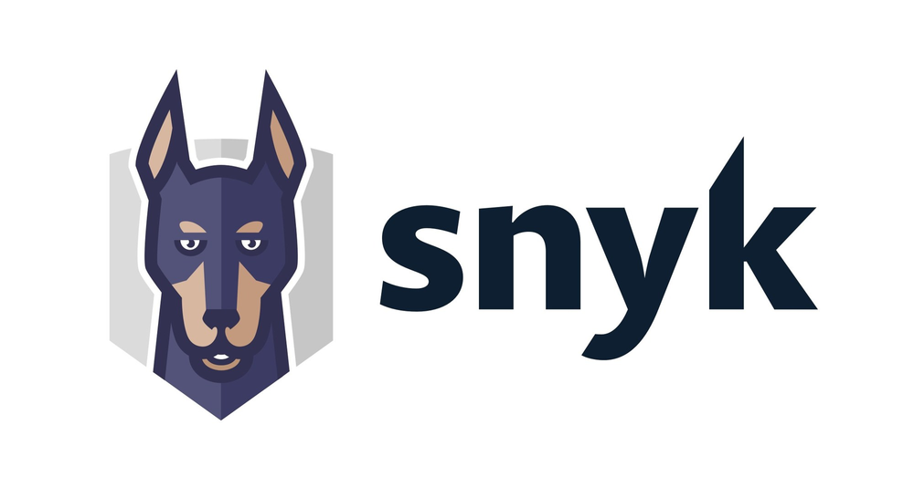
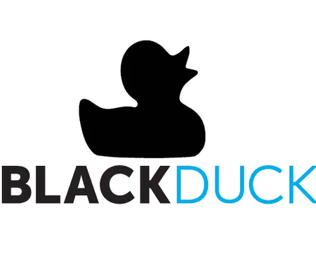
The security aspect
There are things that can help with this:
Snyk
BlackDuck
etc.
Do we trust these results?
most of these are just CVE reports after the fact

Slide 34

The legal and compliance aspect
If you’re using these projects for non-commercial or personal use, it’s pretty easy.
What happens with these things make it into a product? Is it used to create a commercial product? Are you aware of the licenses used/accepted?
is there any risk from using OSS in my product?

Slide 35
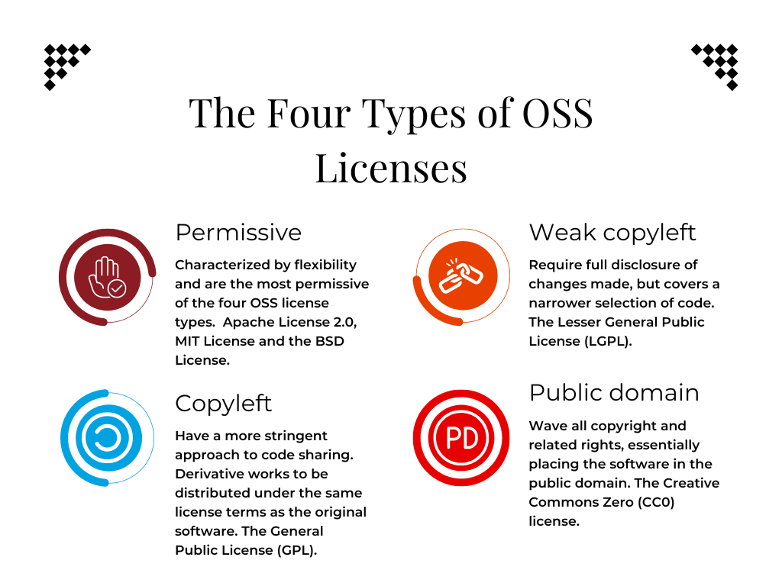
The legal and compliance aspect
licenses galore
tools can help here

Slide 36
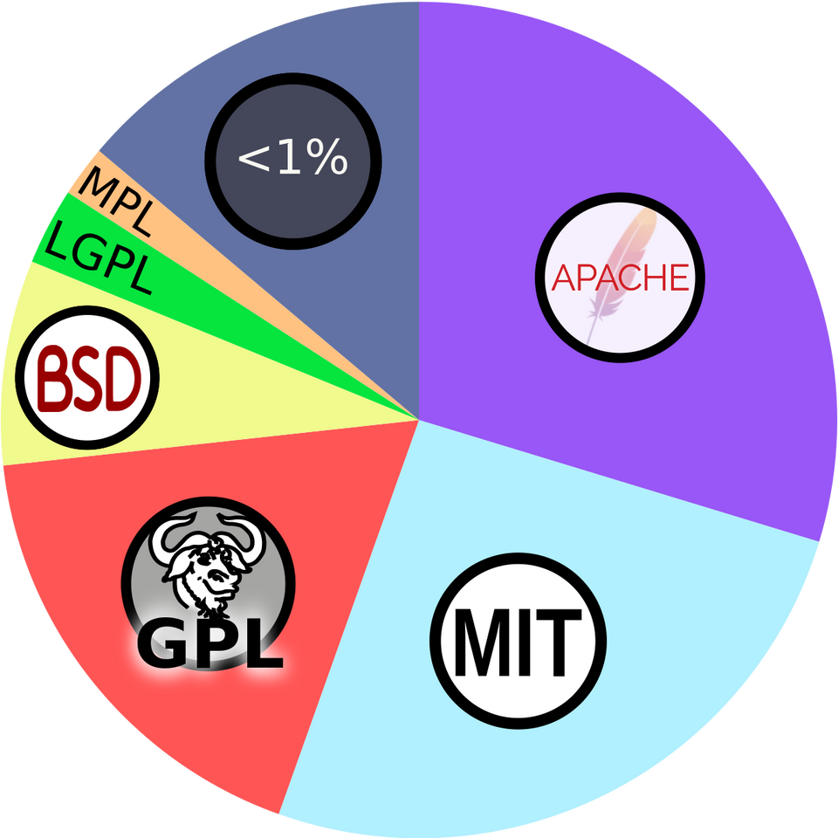
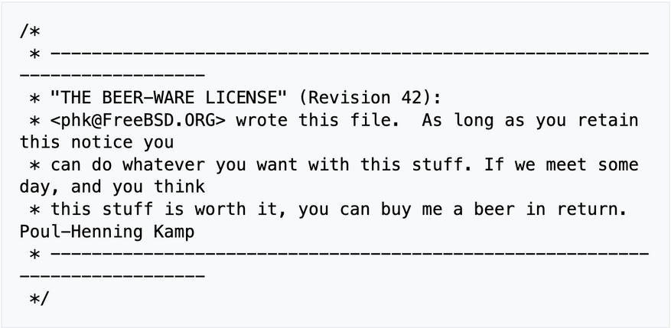
Diving into the licenses...
There’s at least 3 of them:
GPL
Beerware
WTFPL
Notes:
GNU General Public License – Richard Stallman
Beerware - Poul-Henning Kamp
Do What The Fuck You Want To Public License - Banlu Kemiyatorn, Sam Hocevar

Slide 37
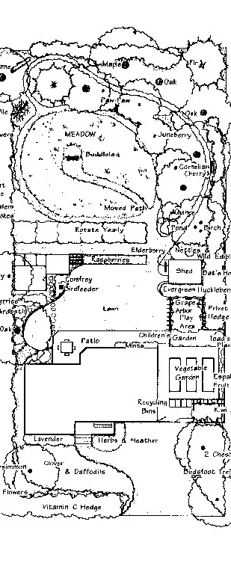
The maintenance aspect
maybe you’ve found a project your company can use both legally and the security risks have been accepted: how do you make sure it remains supported for years to come?
if it becomes abandonded, are you or your company prepared to support it?
why did they stop developing that project? why was it archived?

Slide 38

The longevity aspect
some open-source projects have been around a while, some are fresh and new
do we inherently trust older projects more?
this project is only a few weeks old...

Slide 39
who knows what CVE this is?
CVE-2024-3094

Slide 40
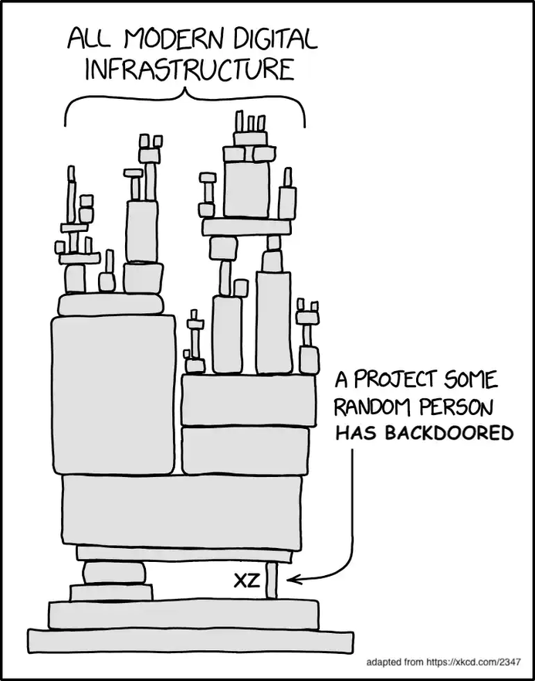
xz vulnerability
jia tan took advantage of everyone’s trust for a well established, long existing open-source project and repository

Slide 41
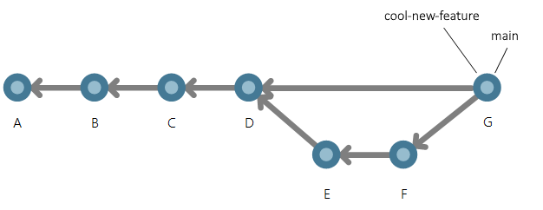
05 - Contributing to open-source
why contribute?
because you should!

Slide 42
Contribution Guidelines
`contributing.md`
Look for it in the repo
If there isn’t one, you can still contribute
Try to match the style guide already in the code base
Don’t reformat the entire codebase just for your PR

Slide 43
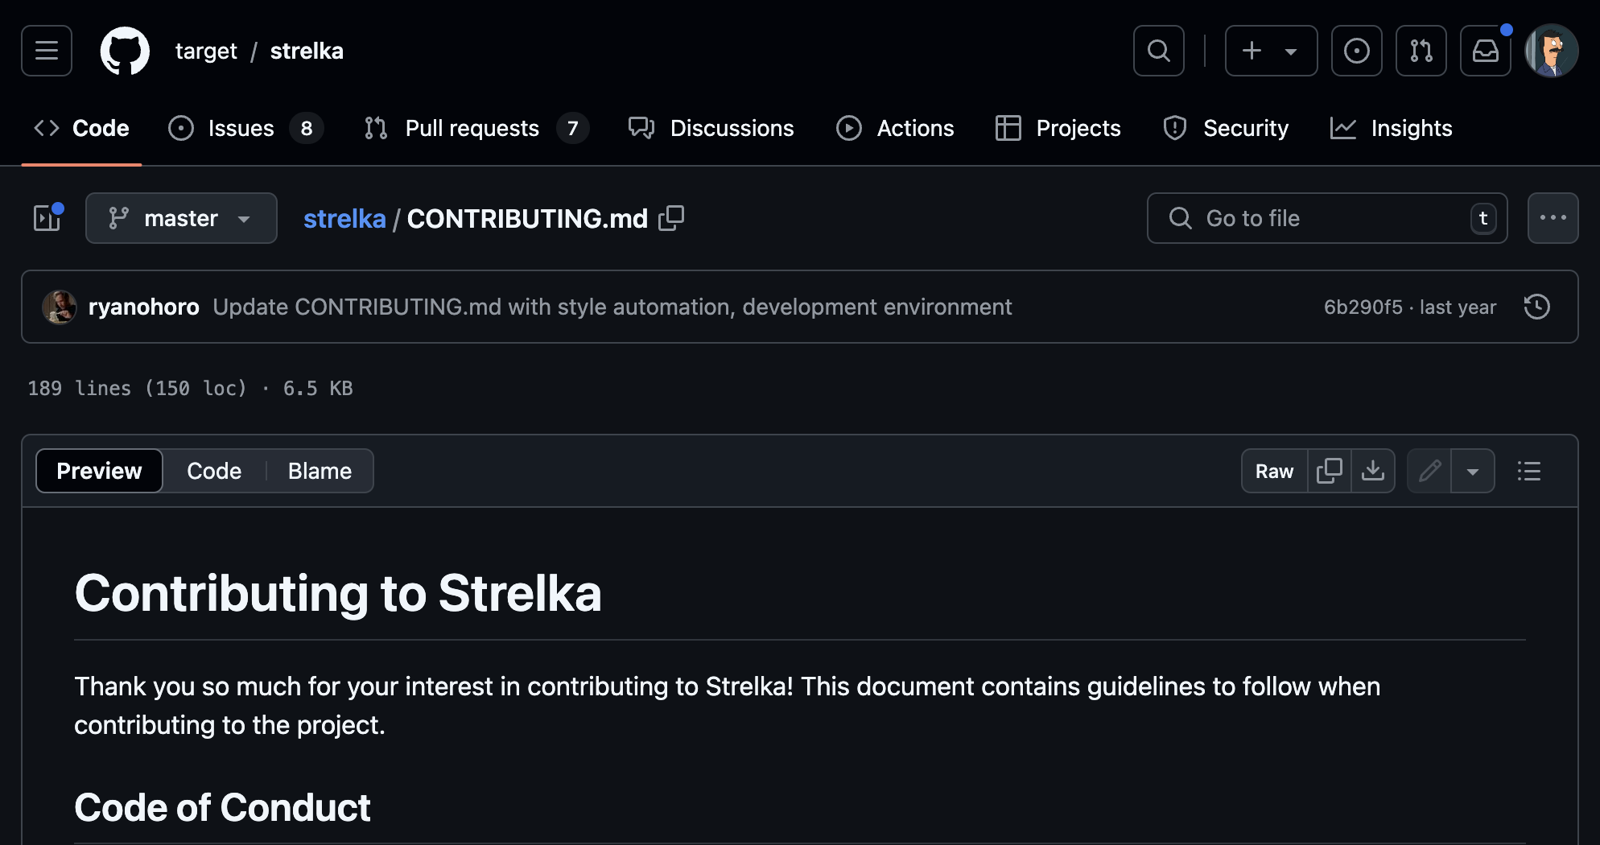
Contribution Guidelines

Slide 44
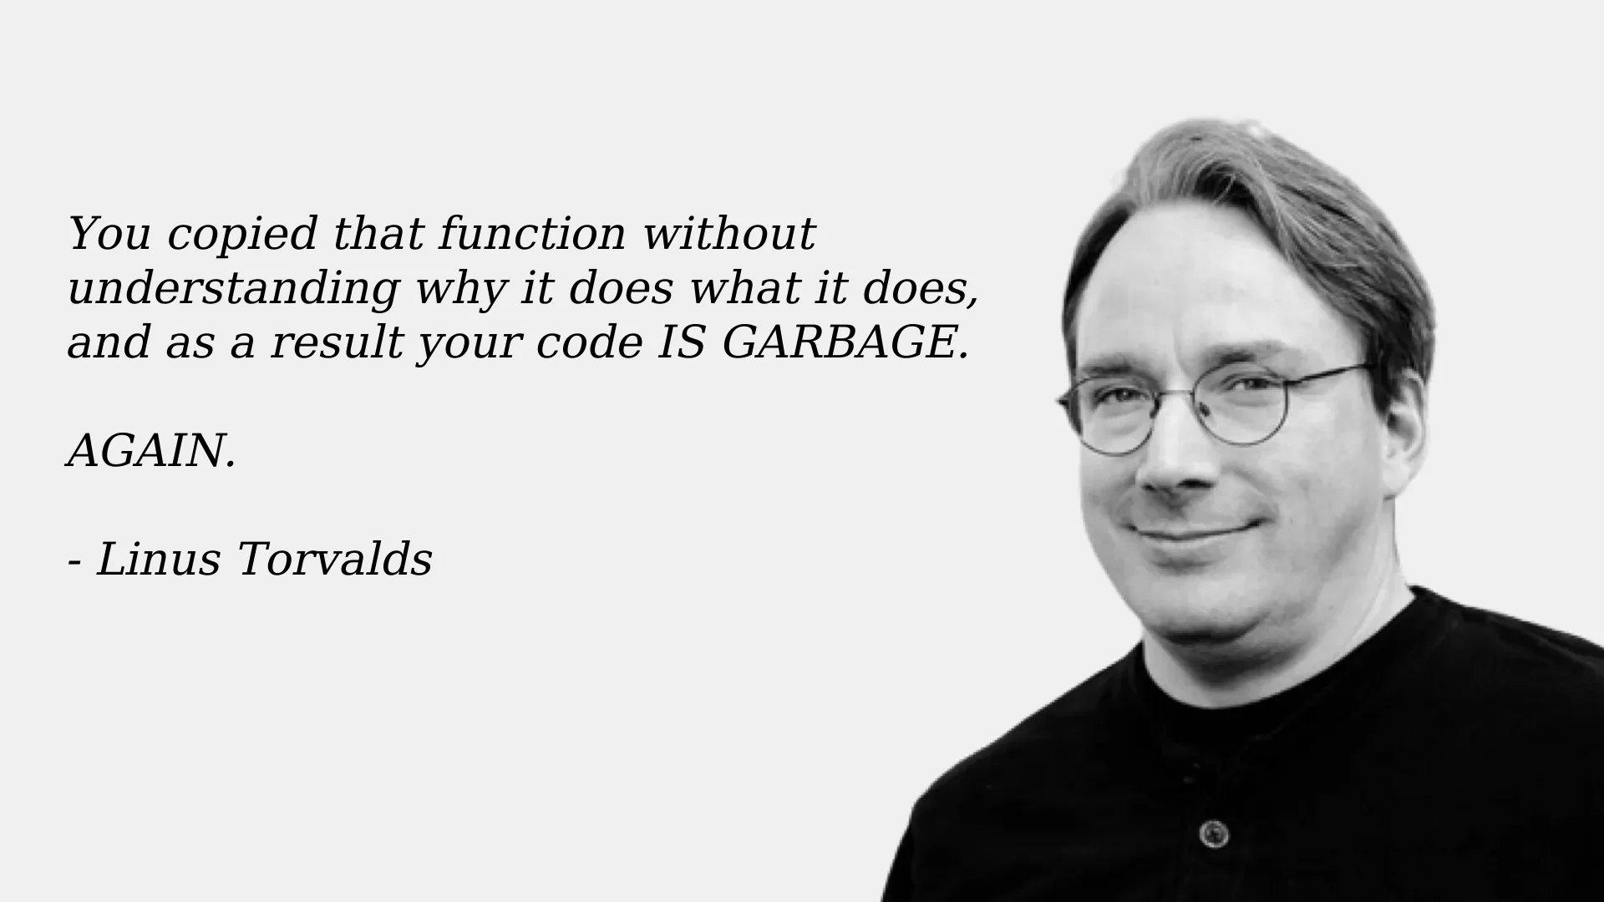
Contributing via Code
What do contributions look like?
- Doc fixes (typos or new/better documentation)
Bug fixes
New features

Slide 45
Funding Guidelines
Funded purely via community support
Funded via organization donations
Support does not always need to be monetary
Helping document issues
Answering those beginner questions
Letting the developers develop

Slide 46
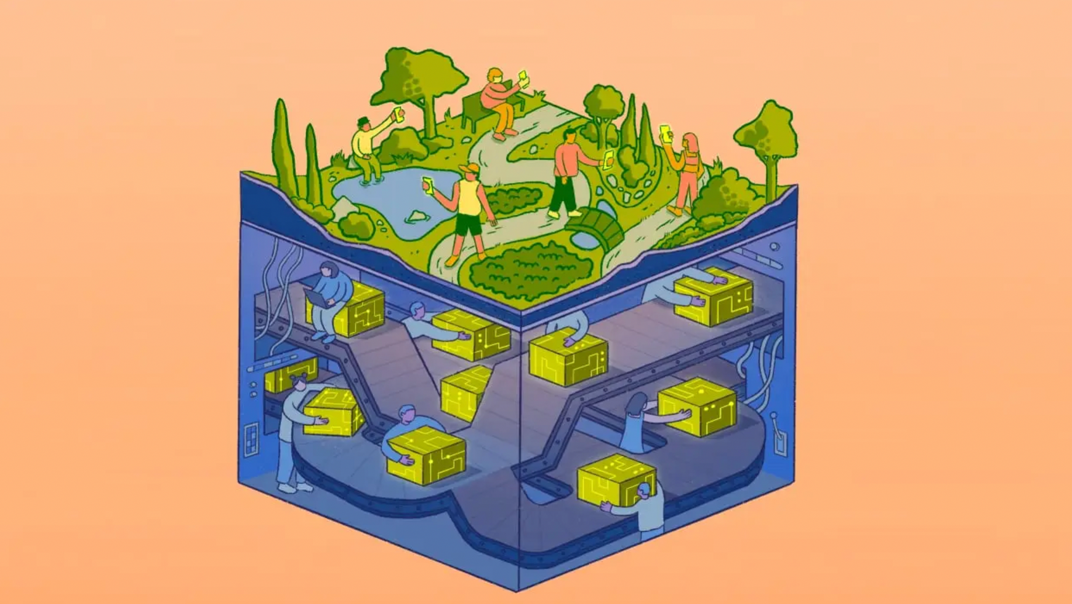
06 - Modern open-source projects
Serving is the act of starting each point in tennis

Slide 47
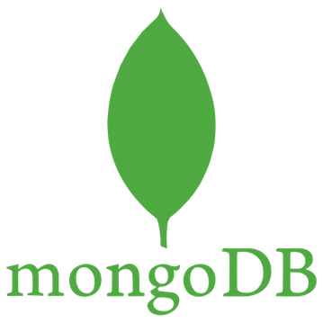
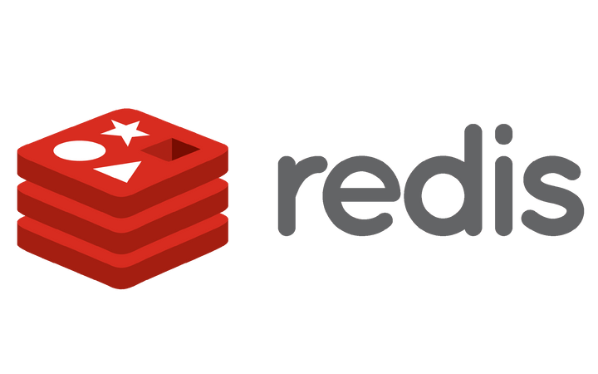
Server Side Public License
based on AGPL
NOT considered open-source by the open source initiative
why is this?
drama, mostly
Notes:
The reason why the SSPL is not Open Source is pretty simple: it doesn't convey the four essential freedoms of free software [1]. That's it, there is essentially no more to it: it imposes usage restrictions, and that's orthogonality against the spirit.
Fedora considers the Server Side Public License (v1) to be a Non-Free license. It is the belief of Fedora that the SSPL is intentionally crafted to be aggressively discriminatory towards a specific class of users.

Slide 48
Why does SSPL actually matter?
Prohibitive
Control
Competition
Notes:
The reason why the SSPL is not Open Source is pretty simple: it doesn't convey the four essential freedoms of free software [1]. That's it, there is essentially no more to it: it imposes usage restrictions, and that's orthogonality against the spirit.
Fedora considers the Server Side Public License (v1) to be a Non-Free license. It is the belief of Fedora that the SSPL is intentionally crafted to be aggressively discriminatory towards a specific class of users.
https://ssplisbad.com/

Slide 49
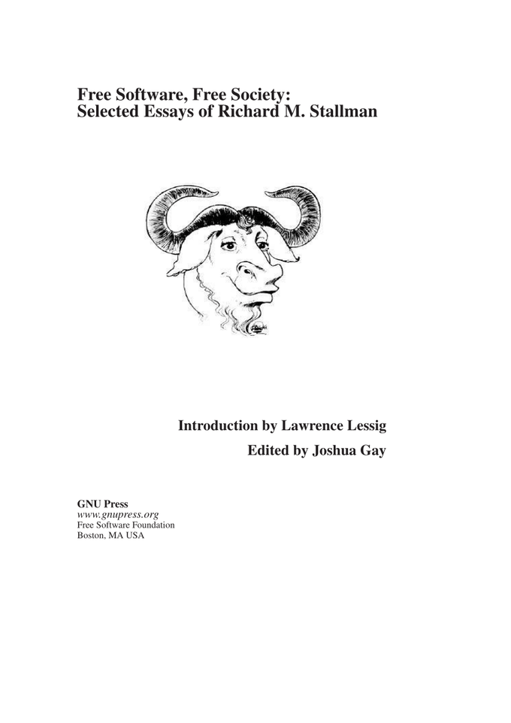
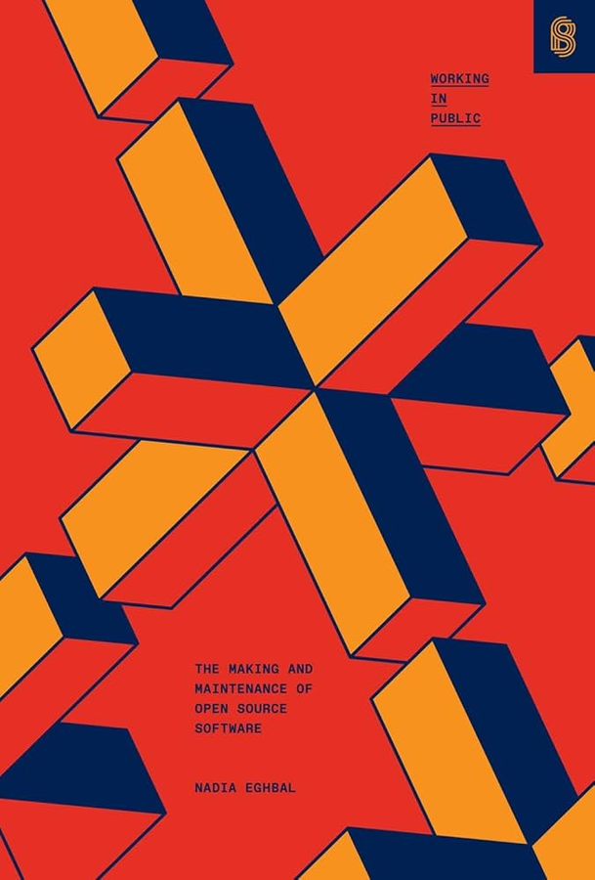
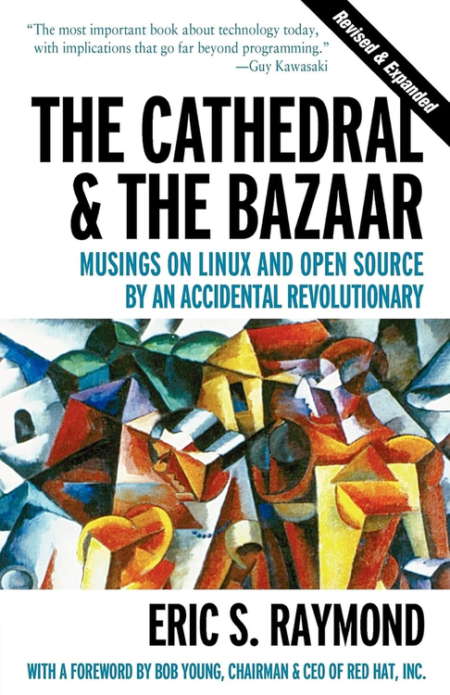
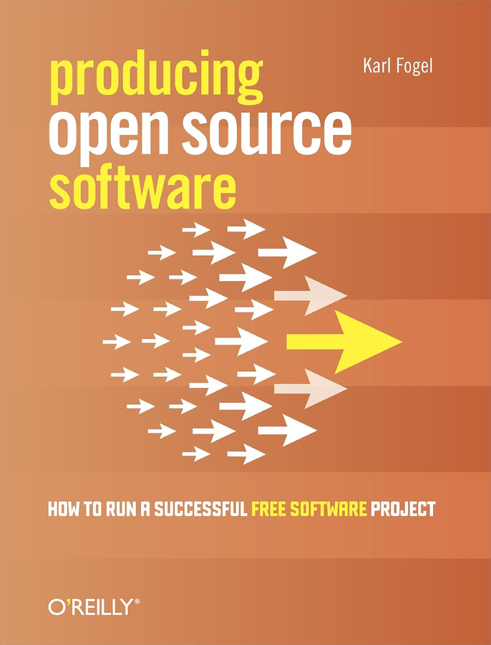
Dive Deep into Open Source

Slide 50

0x00
Jacob Latonis

